Slide 1
Effects of RF Emissions on Clock Drift
Brian McRee
Bryan Luu
Jacob Sanchez
Jason Dykes

Slide 2
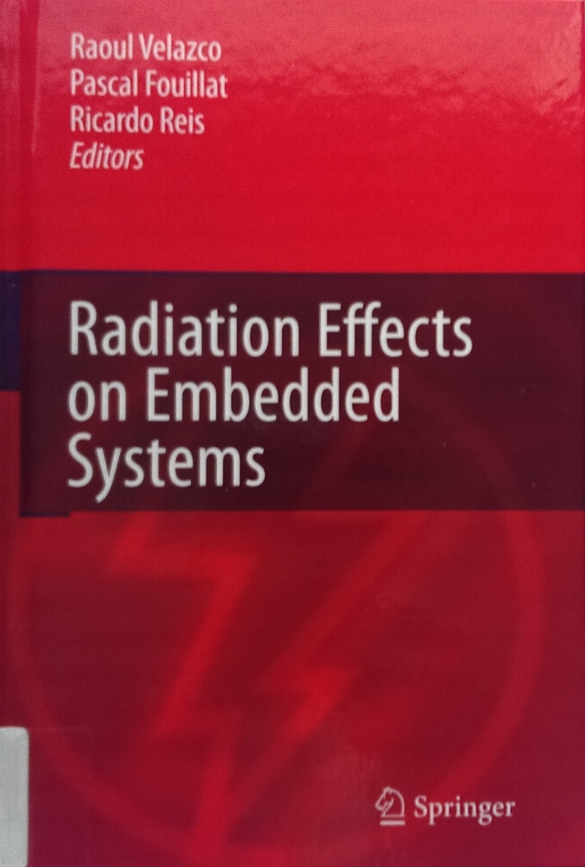
Introduction
There is a significant body of work on how radiation causes faults in electronics and embedded systems [1].
No quantitative data on how common RF (radio frequency) emissions effect clock drift in an internal RC (resistor-capacitor) oscillator found in many microcontrollers.
Figure 1: Text detailing radiation tolerance of electronics [1]

Slide 3
Purpose of Research
To observe quantitatively the effects of RF radiation on RC oscillator clock drift.
To determine the viability of internal RC oscillators in environments containing RF radiation.
Reduce the designers need to rely on assumptions or guesswork when selecting clock sources.

Slide 4
Primary Objectives
To gather data on internal RC oscillator clock frequency drift
The independent variables are frequencies and power densities
The dependent variable will be the frequency of the clock
To test 6 units of 5 microcontroller part numbers of 4 different vendors
Total of 120 devices with 3 of each part number being in the control and test groups
To apply treatments of the independent variables
7 common frequencies at 4 corresponding power densities

Slide 5
Testing Overview
60 total parts in the control group receive treatments of no RF emissions
Subtotal: 60 treatments
60 total parts in the test group receive 28 treatments each
Subtotal: 1680 treatments
1740 treatments total
3600 data points per test results in 6,264,000 total data points

Slide 6
Secondary Objectives
To present data collected as percent error for each unit tested
Data for each chip grouped to their corresponding part number
Statistical averages and variances will be produced for each part number
To present data collected graphically for each part number
Graph independent variable is time in seconds
Graph dependent variable is frequency recorded at the corresponding time

Slide 7
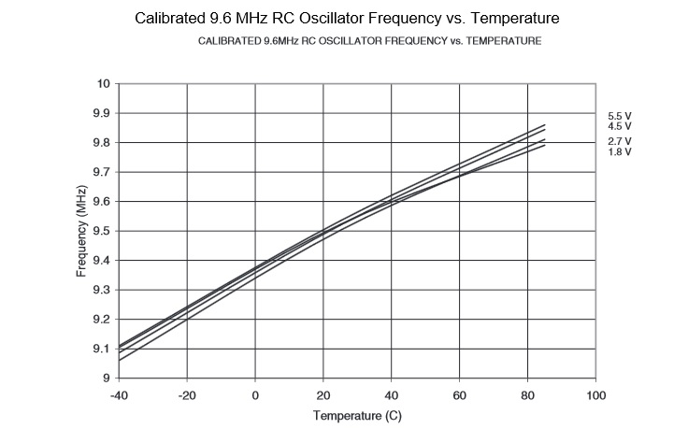
Background
Mechanically resonant devices and RC oscillators
Both types sensitive to EMI [2]
Not quantitatively known
RC Oscillators are sensitive to temperature variation. [2]
Figure 2: Clock frequency due to Temperature [3]

Slide 8
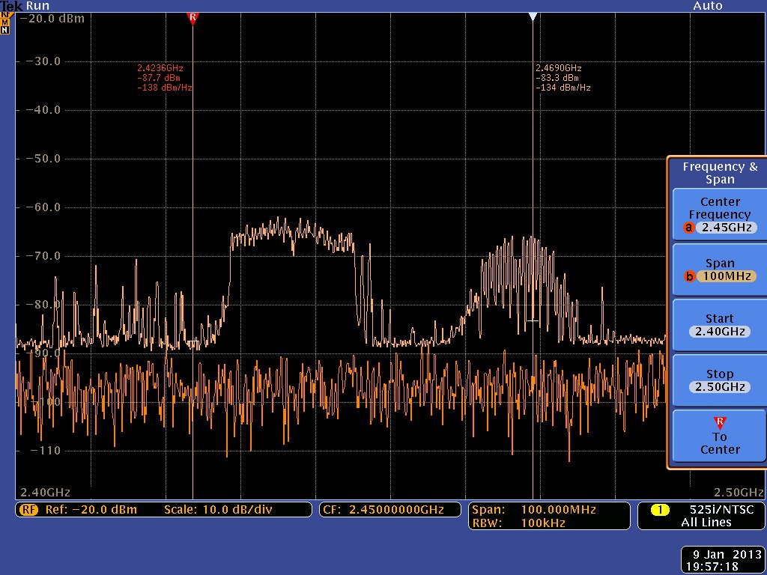
Background Cont.
Previous documentation cites common frequencies
“Cellular phones, CB radios, TV and radio stations, amateur radios and fire and ambulance radios” [4] (1994)
Necessary inclusion of current widespread 2.4GHz and 5.5GHz Wi-Fi signals
Figure 3: Spectrum analyzer centered at 2.4GHz [5]

Slide 9
References
[1] Velazco Raoul, Pascal Fouillat, and Ricardo A. L. Reis. Radiation Effects on Embedded Systems. Dordrecht: Springer, 2007. Print.
[2] Maxim Integrated. "Application Note 2154: Microcontroller Clock—Crystal, Resonator, RC Oscillator, or Silicon Oscillator?" Maxim Integrated. Maxim Integrated Products, Inc., 10 Sept. 2003. Web. 20 Sept. 2015.
[3] Atmel. "ATtiny13A." 8126F-AVR-05/12 (2012): 154. May 2012. Web. 30 Sept. 2015.
[4] Getz, Robin, and Bob Moeckel. "Understanding and Eliminating EMI in Microcontroller Applications." Texas Instruments. National Semiconductor, Aug. 1996. Web. 25 Sept. 2015. Literature Number: SNOA382
[5] Gervasi, Charles. "Tektronix MDO4000 Series Review." Recent Posts. Element14, 11 Feb. 2013. Web. 01 Oct. 2015.

